Slide 1
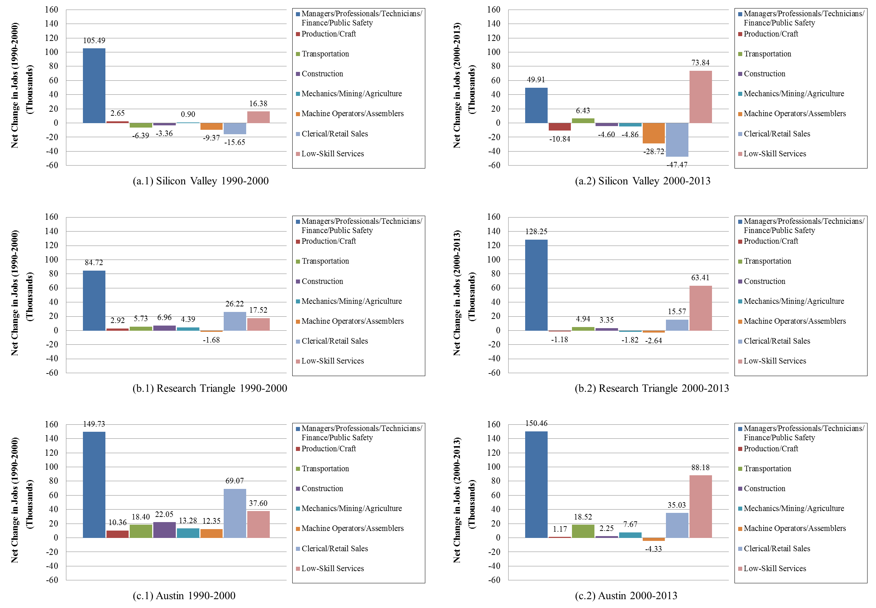

Slide 3
Austin, TX: Austin-Round Rock MSA
Silicon Valley, CA: San Mateo and Santa Clara counties
Bay Area, CA: Marin, San Francisco, San Mateo, Alameda, Contra Costa, Napa, Solano, Santa Clara, Santa Cruz, Sonoma, and San Joaquin counties* (San Jose - San Francisco - Oakland Consolidated MSA)
Research Triangle, NC: Chatham, Durham, Wake, and Orange counties**
*San Benito county included in 2013
**Lee county included in 2013

